Slide 1
ARGO CD
A Workshop for better understanding

Slide 2
Agenda
Introduction
How it works
Features

Slide 3
Introduction
Open-source GitOps continuous delivery tool
Declaratively-defined infrastructure stored in a Git repository
Can be version-controlled
Application deployment & Lifecycle management is
Automated
Auditable
Understandable

Slide 4
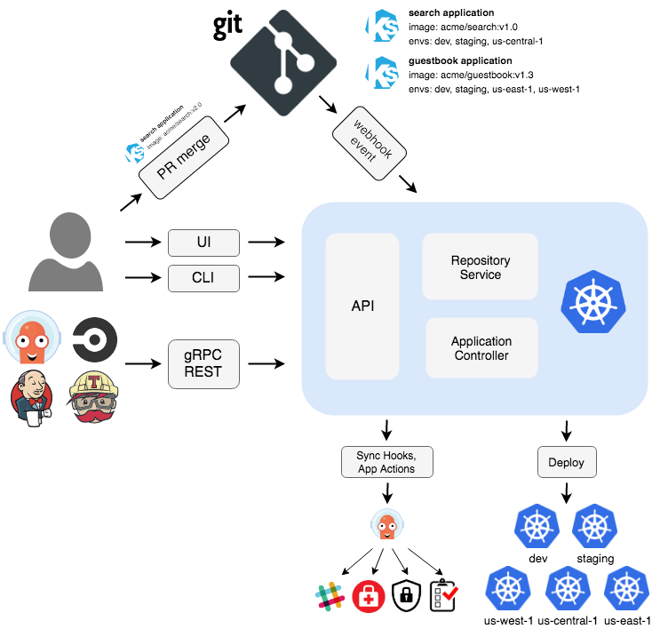
How it works
Argo CD follows the GitOps pattern
Using Git repositories
As the source of truth
Defines the desired application state
Kubernetes manifests can be specified as
kustomize applications
helm charts
jsonnet files
Plain directory of YAML/json manifests

Slide 5
Features
Automated deployment of applications to specified target environments
Support for multiple config management/templating tools (Kustomize, Helm, Jsonnet, plain-YAML)
Ability to manage and deploy to multiple clusters
SSO Integration (OIDC, OAuth2, LDAP, SAML 2.0, GitHub, GitLab, Microsoft, LinkedIn)
Multi-tenancy and RBAC policies for authorization
Rollback/Roll-anywhere to any application configuration committed in Git repository
Health status analysis of application resources
Automated configuration drift detection and visualization
Automated or manual syncing of applications to its desired state
Web UI which provides real-time view of application activity
CLI for automation and CI integration
Webhook integration (GitHub, BitBucket, GitLab)
Access tokens for automation
PreSync, Sync, PostSync hooks to support complex application rollouts (example: blue/green & canary upgrades)
Audit trails for application events and API calls
Prometheus metrics
Parameter overrides for overriding helm parameters in Git

Slide 6
Core Concepts
Application
A group of Kubernetes resources as defined by a manifest. This is a Custom Resource Definition (CRD).
Application source type
Which Tool is used to build the application.
Target state
The desired state of an application, as represented by files in a Git repository.
Live state
The live state of that application. What pods etc are deployed.
Sync status
Whether or not the live state matches the target state. Is the deployed application the same as Git says it should be?

Slide 7
Core Concepts (2)
Sync
The process of making an application move to its target state. E.g. by applying changes to a Kubernetes cluster.
Sync operation status
Whether or not a sync succeeded.
Refresh
Compare the latest code in Git with the live state. Figure out what is different.
Health
The health of the application, is it running correctly? Can it serve requests?
Tool
A tool to create manifests from a directory of files. E.g. Kustomize. See Application Source Type.

Slide 8
Thank You !
Have a Great Day !!

